Slide 1

HOS303A: International Restaurant Concepts
Topic 2

Slide 2
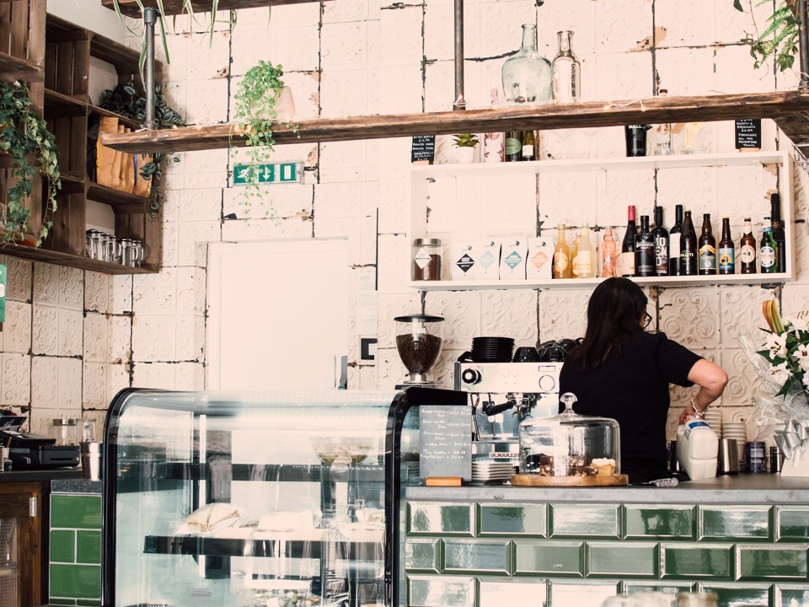
International Restaurant Concepts
Target Markets and Service

Slide 3
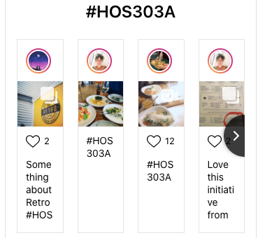
Your Restaurant Adventures…

Slide 4
Weekly Content
Demographics
Target Market
Service
Relating To Concept
Activities

Slide 5
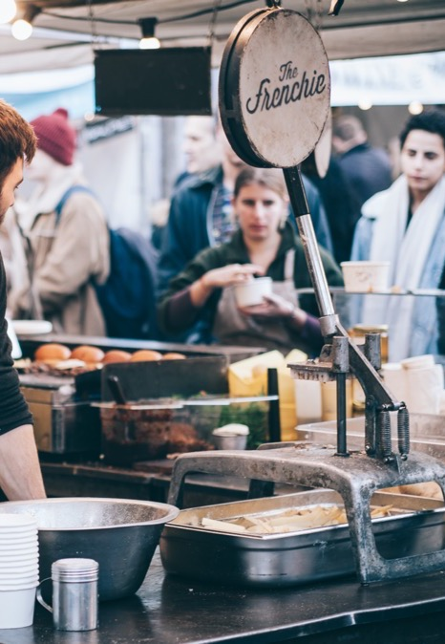

Pre-Class Activity 2.1
Reflect…
In a typical month, how often do you eat outside of your own neighbourhood? Why and where?

Slide 6
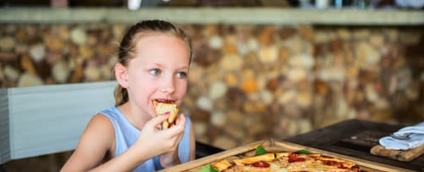
Restaurant Target Market
What’s the USP?
“A target market doesn’t refer to the demographic you want to bring in your restaurant.
Instead, it refers to the specific group of people who are interested in buying what you have to offer.”
(Andrews, 2018, para. 6)

Slide 7
Concept and Market
Quality
Menu
Price
Atmosphere
Location
Management
Food
Service
(Walker, 2014, page 67)

Slide 8
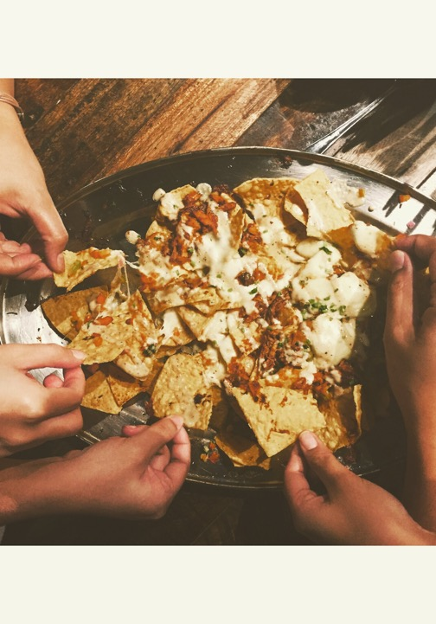
Exploring Target Market(s)
Romantics
Families with young children
Middle Class
Single/ Couples
Teenagers
Gender
Education
Tourists or Locals?
People celebrating special occasions
Personality/ Fun Types?
Occupations
Formal Occasions
Casual Service
In a rush/ quick bite
Anyone hungry?

Slide 9
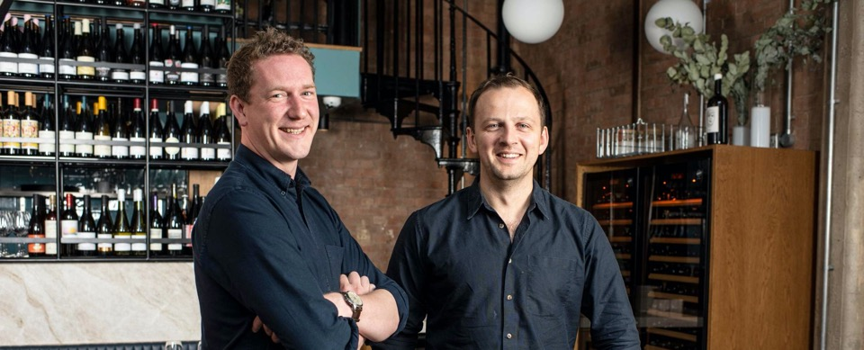
Pearls of Wisdom
“A Tale of Two Restaurants” with John Ogier
(The World’s 50 Best Restaurants, 2020)
Moodle 2.3
Co-owner of Michelin-starred and 33rd Best Restaurant in the World Lyle’s and recently opened Flor in London talks ICMS students through how the demographics of his two venues vary 1 mile apart…
Notes:
Read more here:
https://www.theworlds50best.com/the-list/31-40/Lyles.html
https://www.harpersbazaar.com/uk/culture/going-out/a28337564/lyles-owners-open-flor/

Slide 10

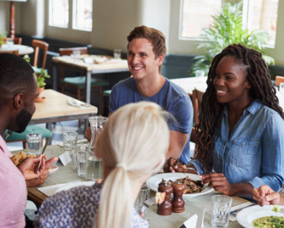
Age/ Generations
Generation Z: Born 1995 to 2014
  Spends money on food above all else
  Prefers quick service and casual dining restaurants
  Grew up with digital technology, thus expect information at their fingertips
  Online prevalence on social media and online review sites is imperative
Millennials: Born 1980 to 1994
  Eats out more often than the general population, with 53% going out to eat at least once a week
  Prefers fresh, natural ingredients
  Prioritises sustainability and ethics
  Prefers fast casual and fine dining over traditional fast food like McDonalds
  Most likely to look at a restaurant’s menu online
*Other sources contradict this
(Target The Market of Your Restaurant)

Slide 11
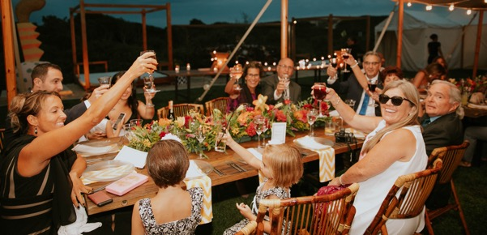

Age/ Generations
Generation X: Born 1964 to 1980
  Prefers organic food
  Places a lot of value on family dining
  Not as digitally savvy as Millennial and Gen Z counterparts
  Still peruse review sites and social media
Baby Boomers: Born 1946 to 1964
  Many baby boomers report being on a diet
  They spend a significant amount of money eating out
  Aren’t as tech savvy as their kids and grandkids, but they’re trying

Slide 12


But, also consider…
Woman in her 20s: prefers low-calorie meals
Mother in her 20s: preference for low-calorie meals, but frequently dines at a pizzeria because of her kids

Slide 13
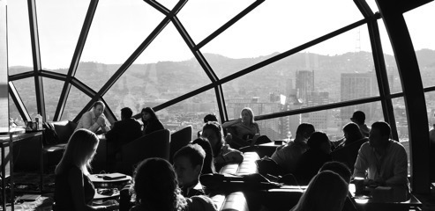
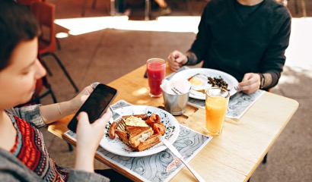
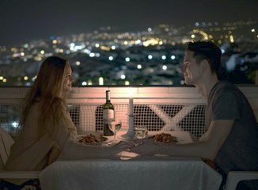
Visit the Competition…
Observe types of people at similar venues:
General age range of customers
Ratio of men vs. women
Style of dress: formal, casual, work attire, trendy, relaxed, workout wear
Group dynamics: family, friends, partners, business, solo, tourists
What people are ordering
Atmosphere: lively, subdued
Music: elevator music, background music, live music, acoustic
Nationalities/ Spoken Languages
Go to at least three competitors, look for trends, if possible, more than once at different times…
(Target The Market of Your Restaurant)

Slide 14
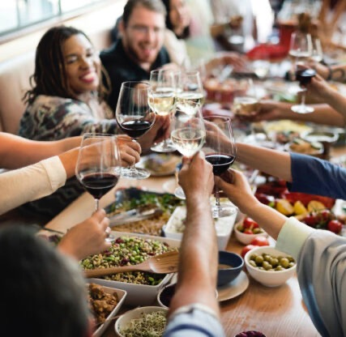
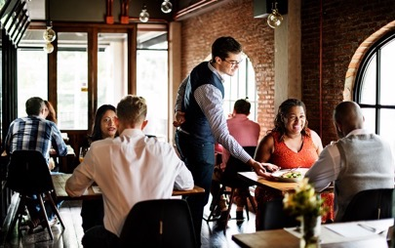
The Challenge
Create a restaurant concept that fits a definite target market, a concept better suited to its market than that presented by competing restaurants, and to bring it into being.

Slide 15

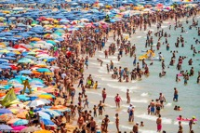

Tourists and Seasonality
Seasonal Holidays and Restaurants
Thriving in Summer
Decline in Winter
Non-weather related seasonal changes
(Higuera, V. & Shoenbureder, E. , 2019)

Slide 16
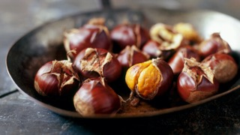

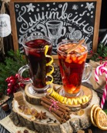
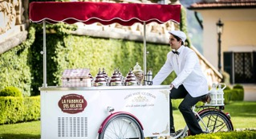
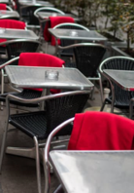
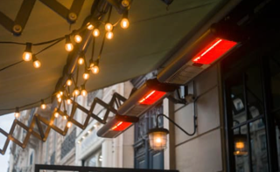
Combating Seasonal Changes and Changes in Demographics
Marketing Campaigns (more on that in future weeks)
Keeping a calendar of events and planning ahead. Incorporating events into the offering- if it’s in line with your concept and location.
Switching up the offering to be more appropriate to the time of year
  Seasonal menus
  Blankets and heaters
  Takeaway picnic baskets
  Home delivery
  Question: What other suggestions do you have?
(Higuera, V. & Shoenbureder, E. , 2019)

Slide 17
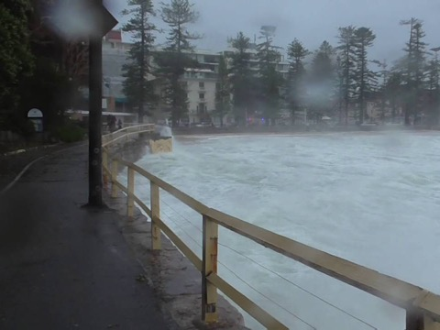
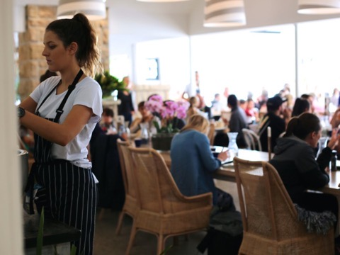
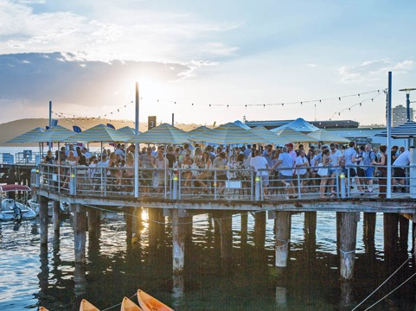
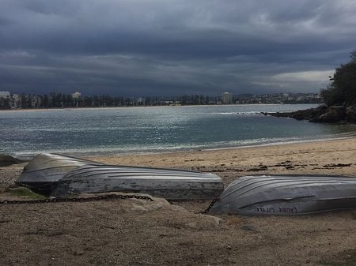
Examples in Manly
Summer vs Winter

Slide 18
Activity 2.4
Research demographics of two chosen suburbs in Sydney. How might their needs differ?
Post your findings to the padlet
Password HOS303A
https://icms.padlet.org/nassima_kennedy1/ga5c9n7z5lep115c
Notes:
This exercise will prepare you for your first assessment.
Useful: https://www.northernbeaches.nsw.gov.au/community/place-making/discover-our-places/strategic-centres/manly-snapshot
https://www.tra.gov.au/domestic/domestic-visitor-profiles/domestic-visitor-profiles
Manly: https://quickstats.censusdata.abs.gov.au/census_services/getproduct/census/2016/quickstat/SSC12475
Darlinghurst: https://dbr.abs.gov.au/region.html?lyr=sa2&rgn=117031329
Microsuburbs: https://www.microburbs.com.au/NSW/Sydney/City/City-of-Sydney/Darlinghurst
Sydney Suburb Guide: https://dreamingofdownunder.com/movetoaustralia/wheretoliveinaustralia/sydney-suburbs-guide-where-to-live-in-sydney/
Tourism Australia Suburb Guide: https://www.australia.com/en-nz/places/sydney-and-surrounds/suburb-guide.html

Slide 19
Example: Chica Bonita
Manly and CBD
Chica Bonita, CBD
Chica Bonita, Manly at night
Menus differ from lighter dishes at lunch time in Manly to suit the different crowds and service periods.
Décor and uniforms are more formal in the CBD
Menus tailored to different demographics
Chica Bonita, Manly daytime

Slide 20
Jose Pizzaro, London
Multi Concept- 2 venues on the same street
Differences in design and menus
Pizarro Restaurant
Pizarro Restaurant
José Tapas Bar
José Tapas Bar

Slide 21
Example: Mo Diner, Momo, Sketch
Multi Concept in the same part of Mayfair, London all with different target markets
Mo Diner
Sketch
Momo
Lower images are venue fronts
Notes:
These venues form part of your second assessment so do take notes.
Mo Diner, more casual and fast paced- can eat at the bar (next door to Momo). Fusion of Mediterranean dishes
Momo slow paced- ethnic restaurant specialising in North African food with a modern twist. Can sit outside and smoke shish and drink mint tea, coffees
Sketch- Eclectic design venue. French with elements of molecular gastronomy- highly instagrammable venue and food. More of a special occasion. A couple of blocks away from the other venues.

Slide 22
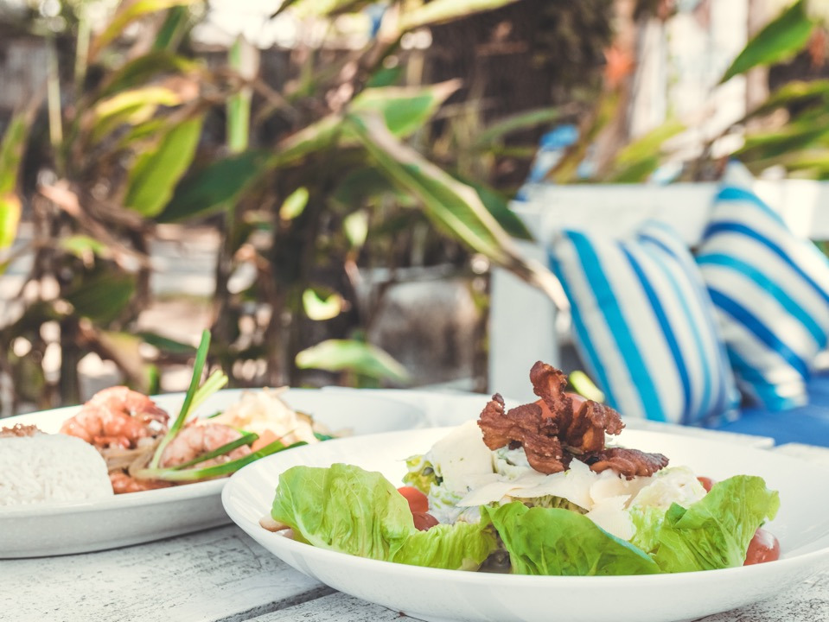
Activity 2.5
Complete a Competitor Demographic Analysis
Select a Restaurant Concept (Café, Thai restaurant etc.) in your neighbourhood.
Complete the Competitor Demographic Analysis Template on Moodle and share your findings at the start of the next class.

Slide 23

Sources
Andrews, A. (2018, October 31). Restaurant Target Market: Find and Understand your USP, Eat. Retrieved from https://restaurant.eatapp.co/blog/target-market-restaurants
Higuera, V. & Shoenberger, E. (2019, February 12). Seasonal Factors Affecting the Restaurant Industry. Retrieved from https://smallbusiness.chron.com/seasonal-factors-affecting-restaurant-industry-31192.html
Target The Market of Your Restaurant (n.d). RestoHub. Retrieved from https://www.restohub.org/operations/planning/defining-your-restaurant-target-market/
Walker, J. R. (2017). The restaurant : from concept to operation. [Book] (8th ed.). John Wiley
Walker, J. R. (2014). The restaurant : from concept to operation. [Book] (7th ed.). John Wiley

Slide 24
Thank you
What questions do you have?...
COMMONWEALTH OF AUSTRALIA
Copyright Regulations 1969
WARNING
This material has been reproduced and communicated to you by or on behalf of International College of Management, Sydney pursuant to Part VB of the Copyright Act 1968 (the Act).
The material in this communication may be subject to copyright under the Act. Any further reproduction or communication of this material by you may be the subject of copyright protection under the Act.
Do not remove this notice.

